Slide 1
Introduction to Further Infectious Disease Modelling
These slides: https://goo.gl/cndxp1
A Spreadsheet and and R Script
Steven Riley

Slide 2
Introductions warning!
Register

Slide 3
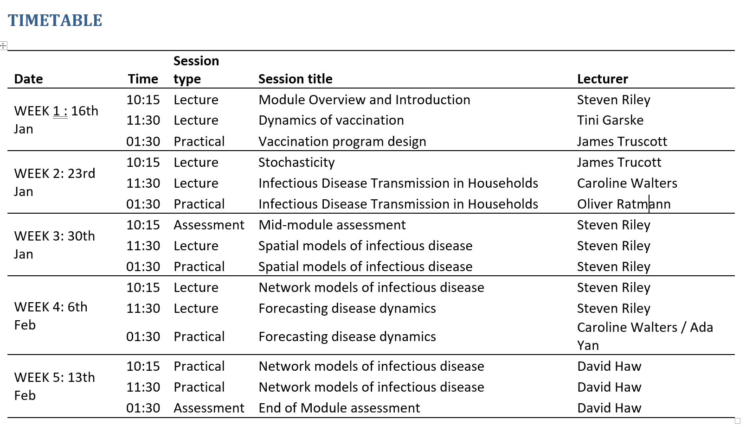

Slide 4
SESSION OBJECTIVES
Understand the objectives of the course
Know what will be expected of you in the assessments
Understand fully an implementation of the SEIR model in excel
Understand how an R implementation of an SEIR model can be constructed
Draw a useful inference from the model
Test the sensitivity of your inference to certain assumptions

Slide 5
OVERVIEW
Course objectives
Methods of assessment
Defining a model
Setting up solutions in excel
Setting up solutions in R

Slide 6
OBJECTIVES
Successful students will
Identify the correct model type and structure for a given epidemiological question
Write key sections of the R implementation of different model-types
Describe precisely how a specific implementation of a model can be used to address a disease dynamic hypothesis
Interpret detailed evidence from infectious disease models similar to that typically presented in non-specialist journals.

Slide 7
OVERVIEW
Course objectives
Methods of assessment
Defining a model
Setting up solutions in excel
Setting up solutions in R
Experimenting with your model

Slide 8
ASSESSMENT
Two in-class coursework sessions
Not intended to be time pressured
First will be designed to be completed within 40 minutes, but students will have up to 60 minutes if needed.
The second will be designed to take 2 hours but students will have 3 hours available
Two types of question
Journal article comprehension questions.
We will also ask model interpretation questions.
Computers will be available so that the code can be executed during the session.
Students may not use the computer for any other purpose than running and editing the example script in RStudio.
Similar assessment has been used for a number of years with the exception that computers have not been available for code to be executed.
Examples of these questions will be made available during the course introduction session.

Slide 9
OVERVIEW
Course objectives
Methods of assessment
Defining a model
Setting up solutions in excel
Setting up solutions in R
Experimenting with your model

Slide 10
THINGS TO KNOW WHEN PLANNING FOR AN INFLUENZA PANDEMIC
How many people will be infected?
How many people will seek treatment?
What will be the peak number infected on a given day?
How sure are we of these numbers?

Slide 11
COARSE ABSTRACTIONS CAN BE USEFUL
Reality
Duplicate reality
Perfect computer simulation
…
…
…
Simple mathematical models
Complexity

Slide 12
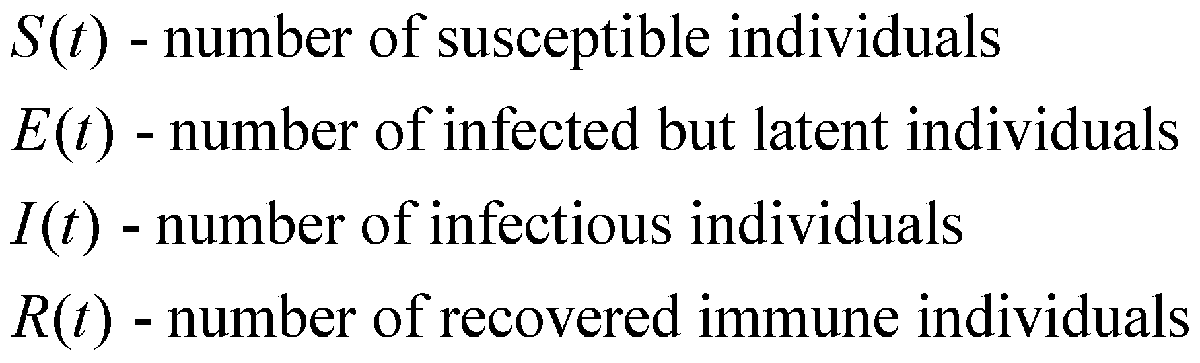
WE WILL MODEL HOW “STATE VARIABLES” CHANGE OVER THE COURSE OF THE EPIDEMIC
S(t)
Infection
E(t)
Become
I(t)
Recover
R(t)
Infectious

Slide 13
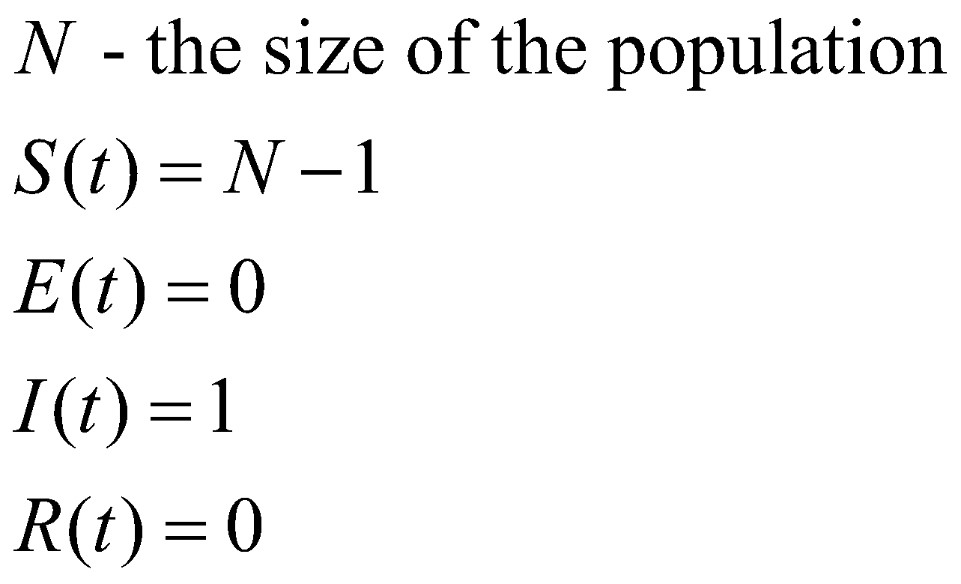
WE NEED TO START THE MODEL FROM SOMEWHERE: INITIAL CONDITIONS

Slide 14
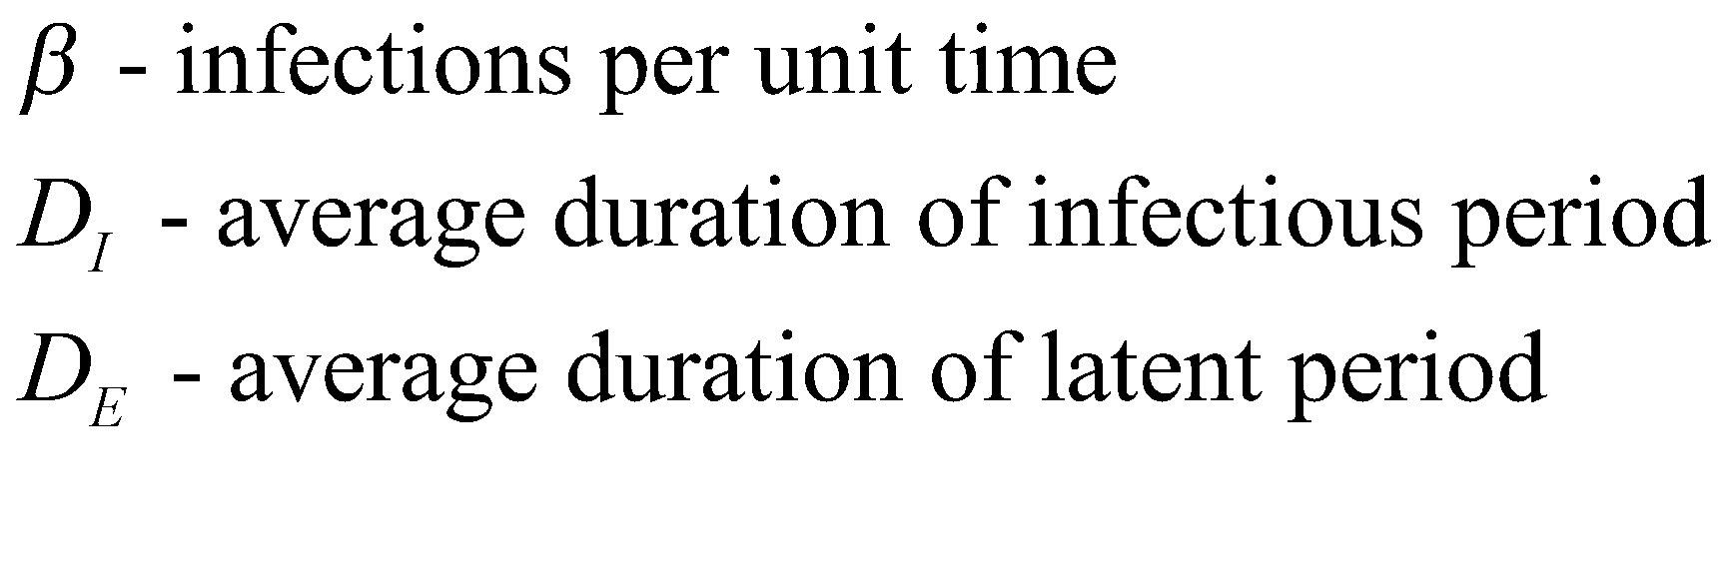
COMMON PARAMETERS

Slide 15
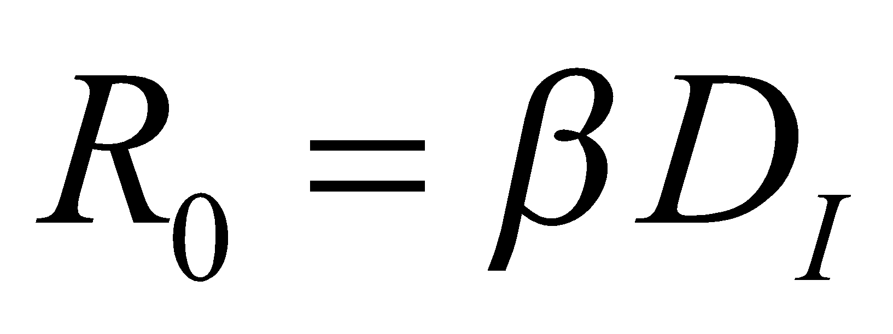
THE BASIC REPRODUCTIVE NUMBER AND THE GENERATION TIME CAN BE EXPRESSED IN TERMS OF MODEL PARAMETERS
“The average number of secondary cases generated by a typically infectious individual over the entire course of their infection”

Slide 16
HAZARDS AND PROBABILITIES ARE DIFFERENT
A hazard is the instantaneous chance that an event happens
  Often thought of in relative terms
  Shark attacks in the morning and at night
A probability tells us how likely something is to happen during a certain period of time
  Lifetime risk of a shark attack for a regular ocean swimmer
Probabilities are often derived from hazards

Slide 17
OVERVIEW
Course objectives
Methods of assessment
Defining a model
Setting up solutions in excel
Setting up solutions in R
Experimenting with your model

Slide 18
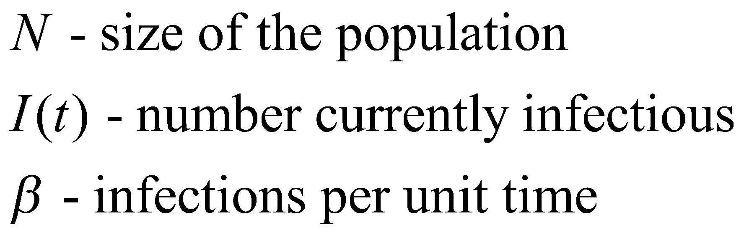
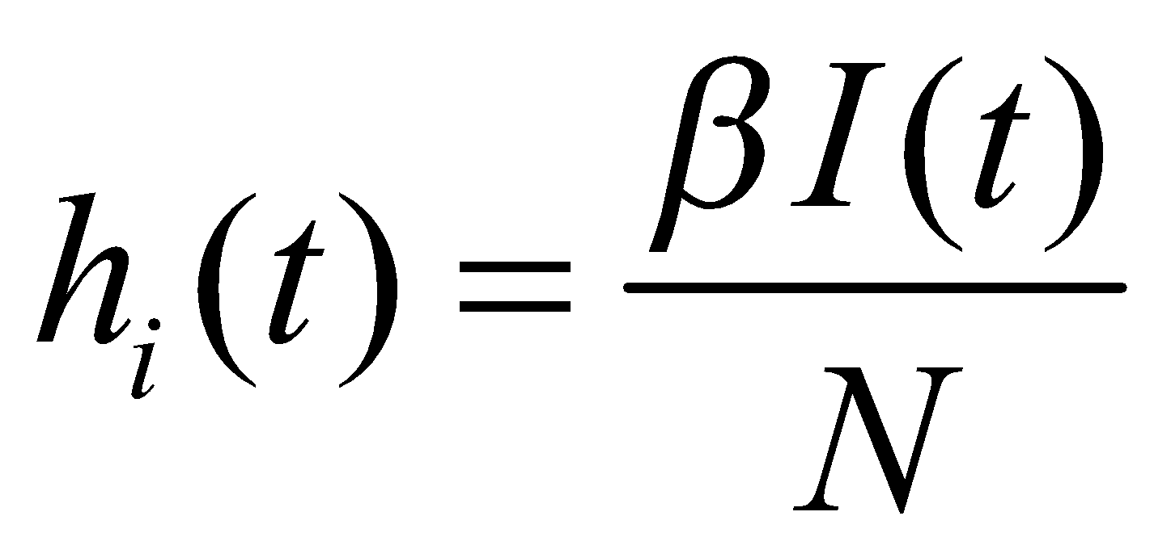
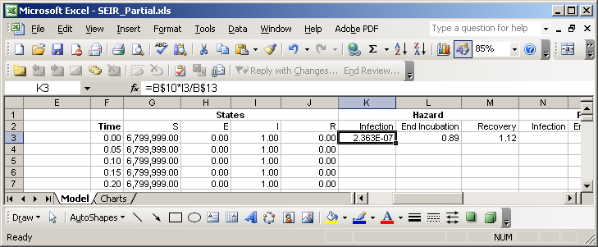
INFECTION HAZARDS FORM THE CORE OF ANY MODEL OF AN INFECTIOUS DISEASE

Slide 19
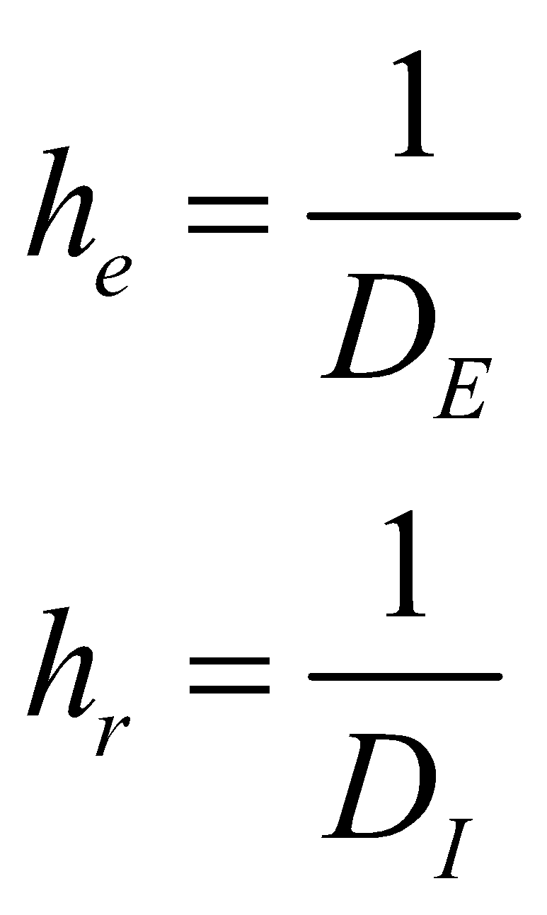
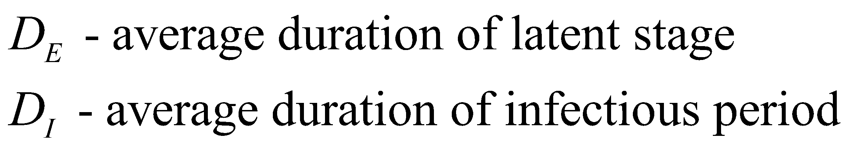
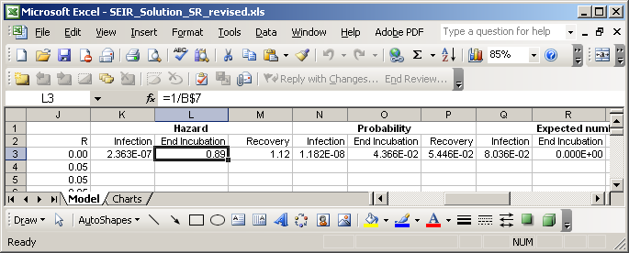
THE OTHER HAZARDS ARE EASY
(FOR THIS TYPE OF MODEL)

Slide 20
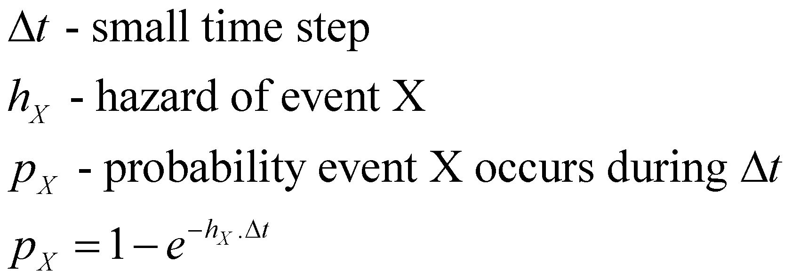
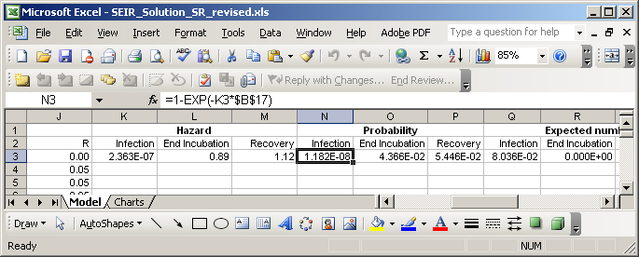
WE CAN CALCULATE THE PROBABILITY OF DIFFERENT EVENTS DURING THE NEXT TIME STEP...

Slide 21
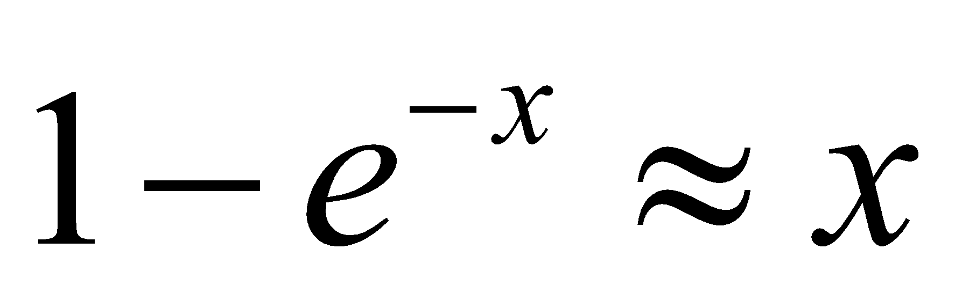
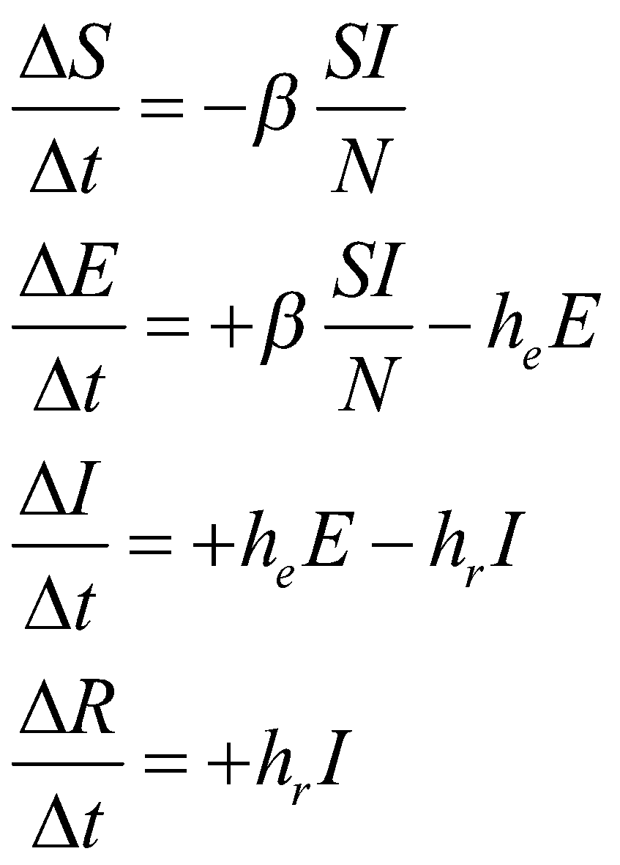
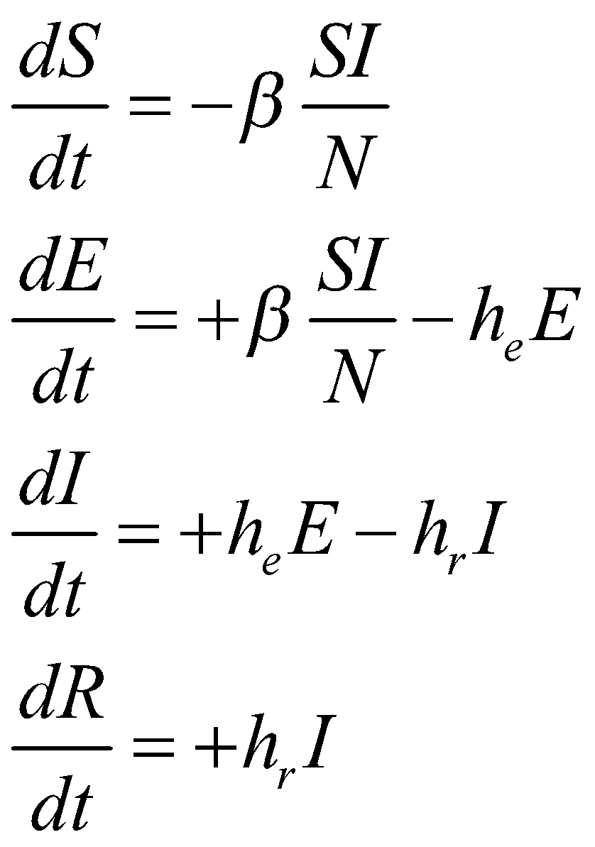
WHEN THE TIME STEP IS SMALL ENOUGH, THIS PROCESS CAN BE APPROXIMATED
BY DIFFERENCE EQUATIONS
For small x:

Slide 22
OVERVIEW
Course objectives
Methods of assessment
Defining a model
Setting up solutions in excel
Setting up solutions in R
Experimenting with your model

Slide 23
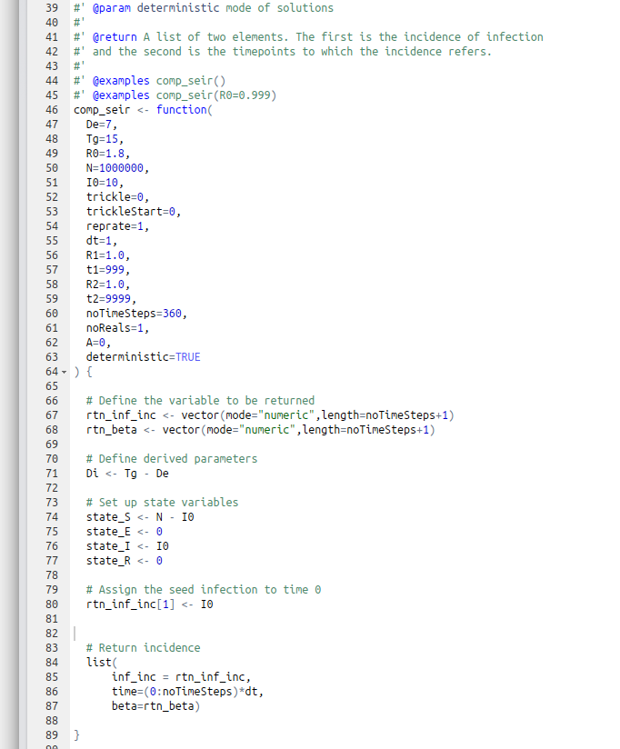
STARTING THE SAME FUNCTION IN R
See SR’s “work in progress” IDD R package
Function definition
Define the output of the function
Return empty results

Slide 24
REFINE, REFINE, REFINE
Write the minimal function definition, then ...
Add the time loop
Add the calculation of the rates
Add the generation of the events
Add the updating of the state variables

Slide 25
OVERVIEW
Course objectives
Methods of assessment
Defining a model
Setting up solutions in excel
Setting up solutions in R
Experimenting with your model
Journal club

Slide 26
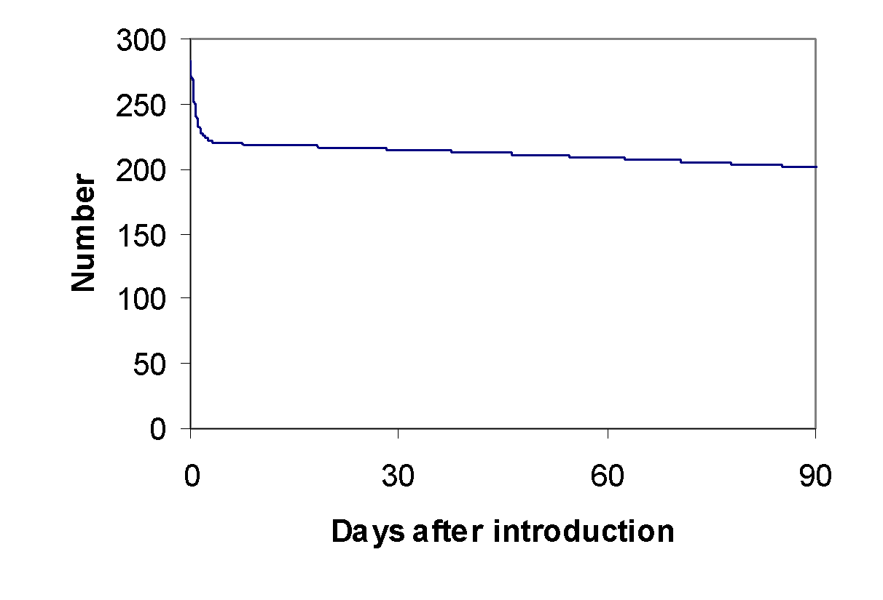
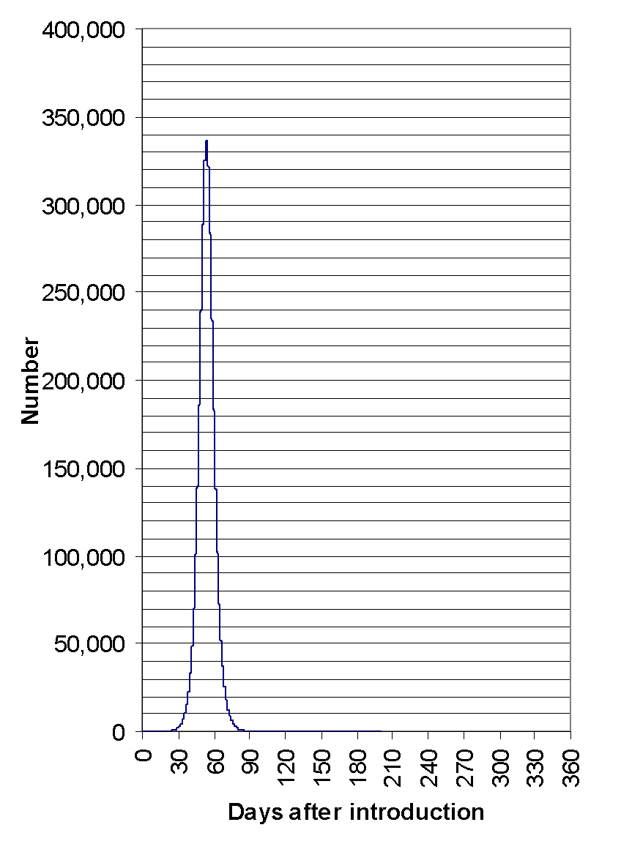
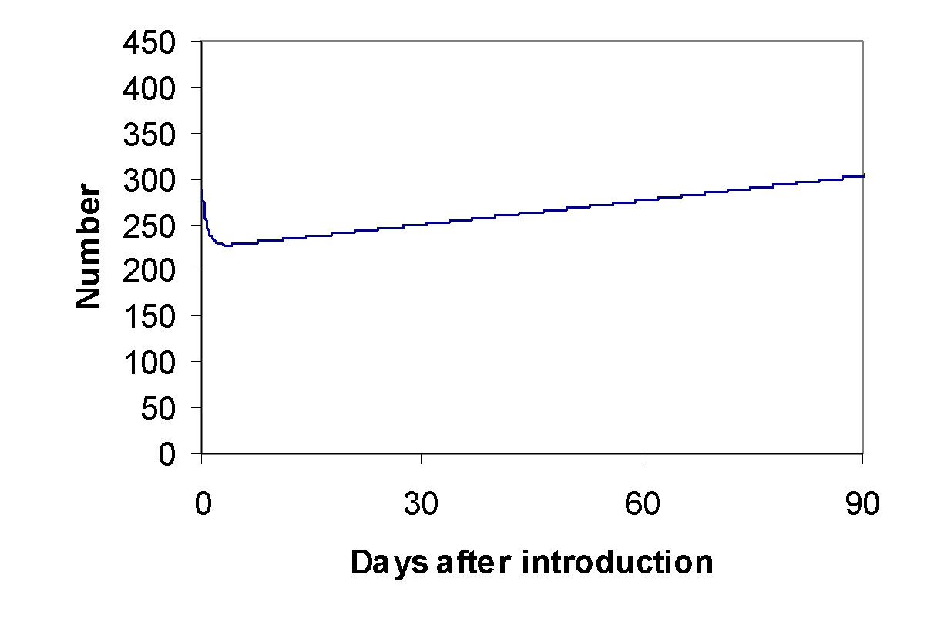
THE EXPECTED PROGRESS OF THE EPIDEMIC CAN
BE SEEN BY ITERATING THROUGH TIME STEPS
Daily incidence curves
R₀=0.99
R₀=1.8
I(0)=1
R₀=1.01
Peak incidence 337,000 (5.0%)

Slide 27
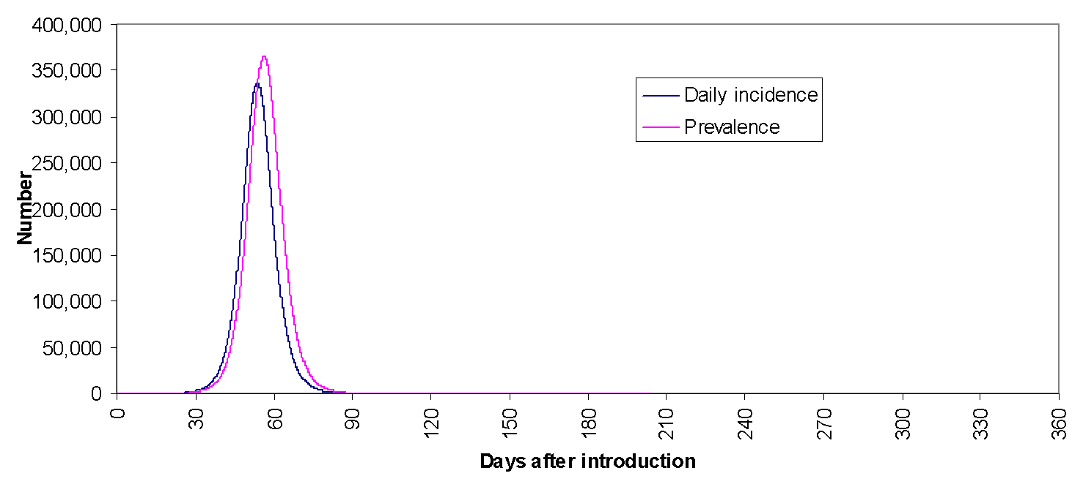
PREVELANCE FOLLOWS FROM INCIDENCE AND
THE RECOVERY PROCESS
Peak prevalence 367,000 (5.4%)

Slide 28
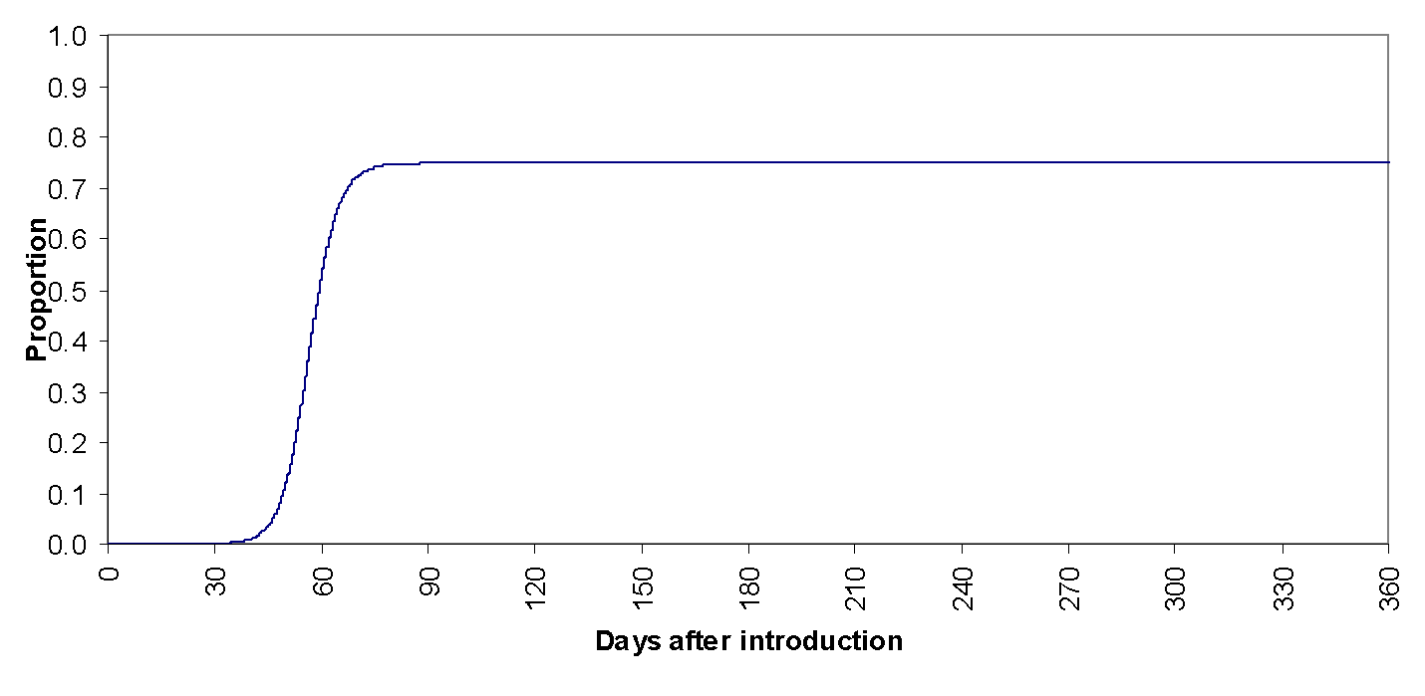
FOR LOW R0 SCENARIOS, THE EXPECTED PROPORTION INFECTED IS SUBSTANTIALLY LESS THAN 1
Proportion of population infected = 74.0%

Slide 29
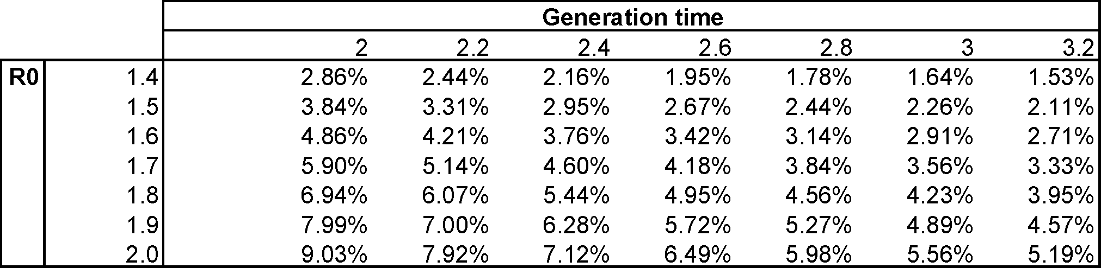
RESULTS ARE SENSITIVE TO REPRODUCTIVE NUMBER AND THE DURATION OF THE LATENT PERIOD (I)
Peak incidence
Incidence most sensitive to R0, but longer generation time reduces expected values substantially

Slide 30
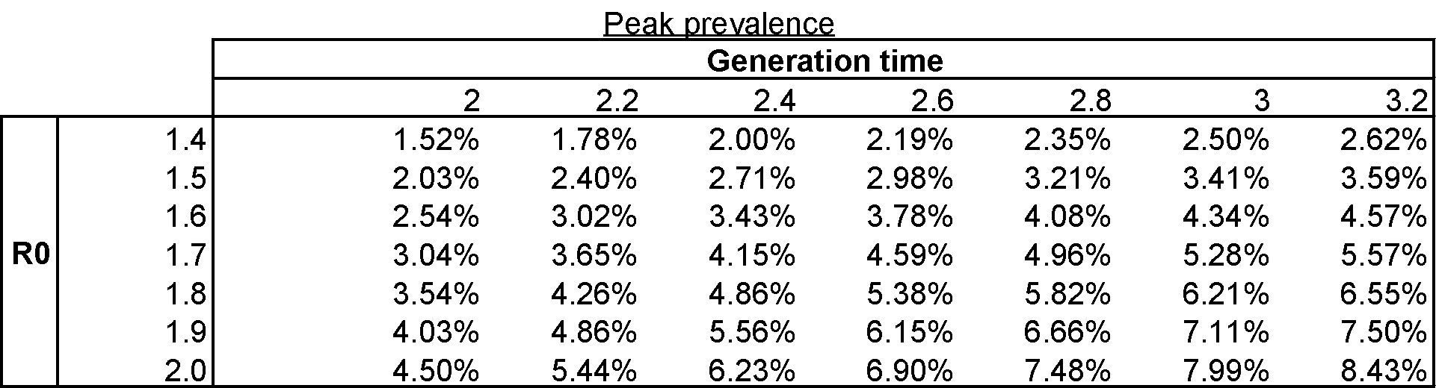
RESULTS ARE SENSITIVE TO REPRODUCTIVE NUMBER AND THE DURATION OF THE LATENT PERIOD (II)
Peak prevalence
Longer generation times will increase prevalence

Slide 31
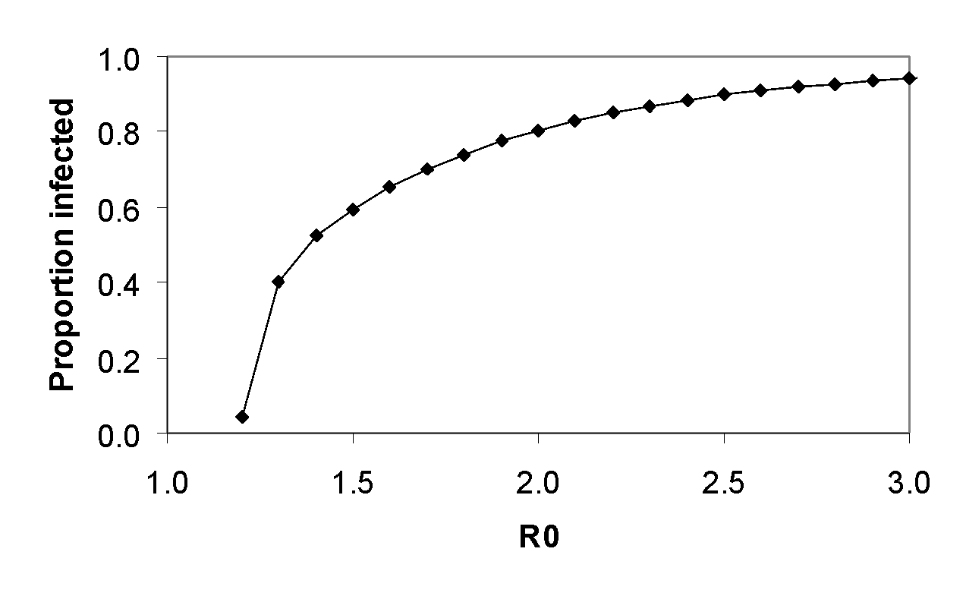
EXPECTED FINAL PROPORTION INFECTED IS ONLY SENSITIVE TO THE BASIC REPRODUCTIVE NUMBER
Proportion of population infected
Below R₀=3, reductions in R₀ will substantially reduce proportion infected

Slide 32
SESSION OBJECTIVES RECAP
Understand the objectives of the course
Know what will be expected of you in the assessments
Understand fully an implementation of the SEIR model in excel
Understand how an R implementation of an SEIR model can be constructed
Draw a useful inference from the model
Test the sensitivity of your inference to certain assumptions

Slide 33
ANY QUESTIONS?

